Slide 1
I Broke it so you don’t have to
HA/DR Fails and fun

Slide 2


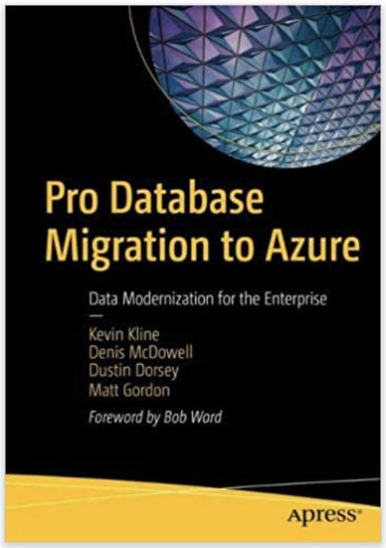
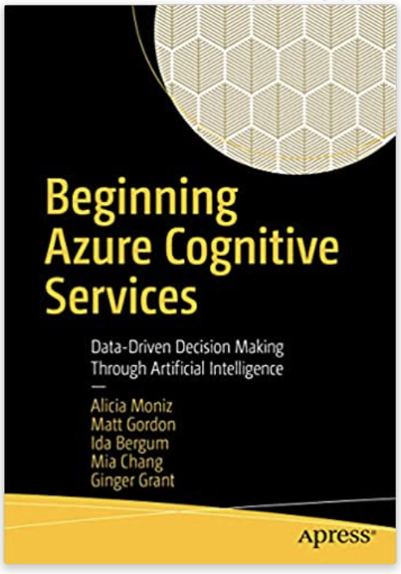
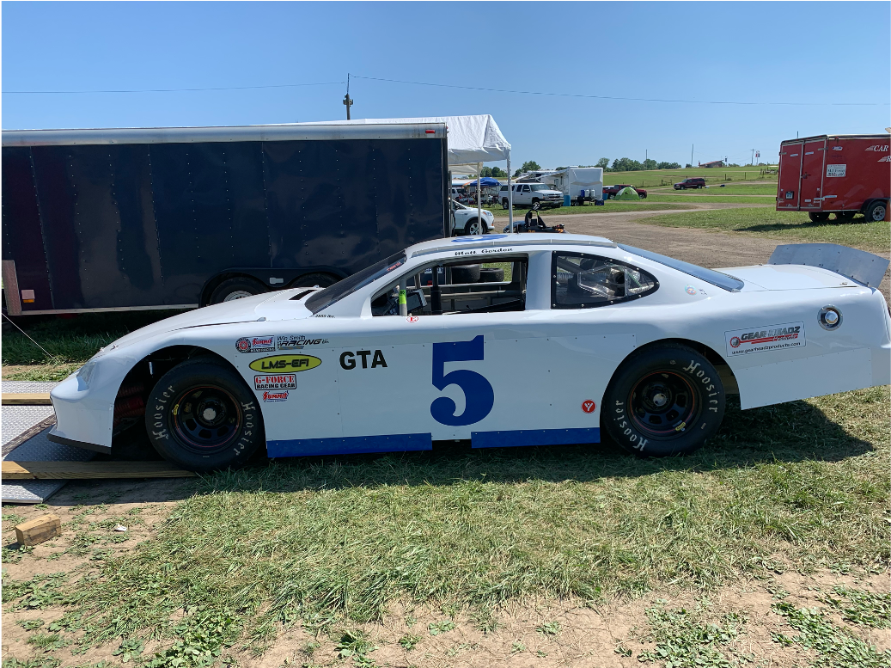
Matt Gordon
Director of Data & Infrastructure
matt@sqlatspeed.com
: @sqlatspeed
www.sqlatspeed.com

Slide 3
LOOKING FOR A NEW JOB?
CLOUD DATA ADMINISTRATOR
CLOUD Infrastructure ADMINISTRATOR

Slide 4


QR CODES FOR JOB LINKS
Cloud Administrator
Cloud Data Administrator

Slide 5


About me
20+ years of SQL Server experience
Microsoft Data Platform MVP
Friend of Redgate
Managed 24x7 datacenters
Leader of Lexington, KY (USA) Data Technology Group

Slide 6
WHAT DID I BREAK?
The technology
The team
myself

Slide 7
STORY TIME!

Slide 8
STORY: constant cluster failures
This is one I actually fixed
Statewide grading and attendance system for schools
Sql server running on a windows cluster
Constant crashes and failovers

Slide 9
What did I learn?
Many times the simplest answer is the correct one
Troubleshooting a high availability issue may not lead you to the ha setup itself
Fresh sets of eyes on a problem can be helpful

Slide 10
STORY: failover test gone wrong
Mandatory failover test around project kickoff
Early adopter of always on availability groups
Cluster design done by networking operations group
Lots of eyes on this test
Pulled the plug – and everything went away

Slide 11
What did I learn?
Everybody involved in an ha setup needs awareness of its components
Cluster quorum is very important
Trust, but verify

Slide 12
STORY: jobs that move money matter
4-node Always on ag
Sql server agent job reporting daily financial data
Mandatory 48-hour failover test
Job not present on replicas – no report, no money

Slide 13
What did I learn?
Make sure processes and procedures failover as well
Make sure those processes and procedures are documented, trained, and practiced
Dbatools is awesome!

Slide 14
What did I learn?
Copy-dbalogin and copy-dbaagentjob made short work of this
Azure data studio notebooks are also awesome and worth a look
The more you automate, the fewer opportunities for mistakes there are

Slide 15
STORY: the cloud isn’t magic
Consulting customer of mine
Wanted to migrate to the cloud but save every dollar possible
Declined the advice of myself (and Microsoft) to build in additional redundancy
Azure ad outage in a single region cut them off from their data for hours

Slide 16
What did I learn?
If you are paying people for their advice, take it
This applies to consultants and your employees
Even the financially backed SLAs will not help you recoup lost business
Remember that the cloud can fail

Slide 17
What did I learn?
Identifying the fault domains in your cloud deployment and mitigating them are key
Balance your need for uptime with your financial needs

Slide 18
How did I break the team?

Slide 19
Do as I say, not as I did
Train your team
Practice your processes
Do not silo the group
People are not robots

Slide 20
How did I break myself?

Slide 21
You are not highly available
Proper procedures
Good partners
Advocate for yourself and the team
“superhero complex” isn’t healthy
Find support where you can
https://dataplatformwit.com/data-platform-wit-mental-health-and-wellness-day-2022/

Slide 22
The slide where I shill for my books
Cognitive services book
Database migration book

Slide 23
QR CODES FOR JOB LINKS
Cloud Administrator
Cloud Data Administrator

Slide 24
THANKS FOR ATTENDING!
Matt Gordon
Director of Data & Infrastructure
matt@sqlatspeed.com
: @sqlatspeed
www.sqlatspeed.com
https://github.com/sqlatspeed/2022_presentations

